Slide 1
Islam, and Christianity
Religious Currents in Africa
And its impact on
African Architecture
Music

Slide 2
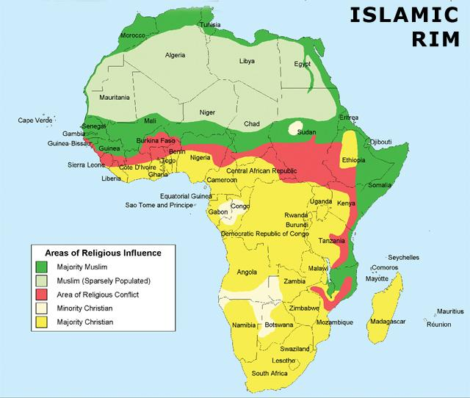
Areas of Religious Influence
Islam in African Society
Is one of 3 Primary Religions throughout the continent: Traditional, Islam, & Christianity
Historically, Islam has had a huge impact on
literacy
wealth and trade
Cultural traditions in Africa, particularly architecture, art, and poetry.

Slide 3
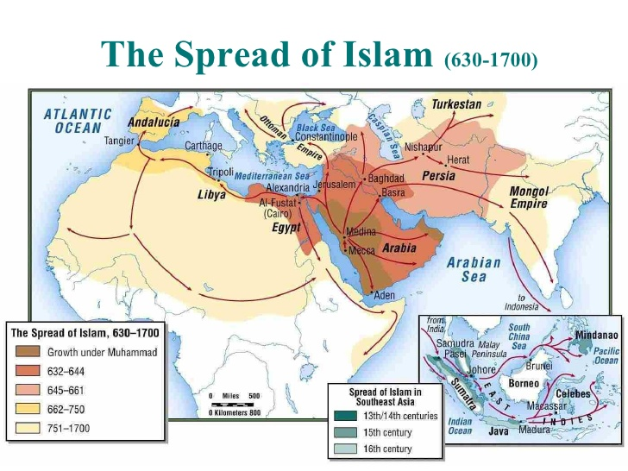
History of Islam in Africa
Africa is the first place where Muslims migrated away from the Arabian Peninsula into another areas.
Eastern Africa [Eritrea and Ethiopia] as early as the 600s

Slide 4
Regional demographics
Islam has the largest influence in North Africa and some northern regions of West Africa, as well as Eastern coastal regions of Africa/
There is a smaller minority population of Muslims in South Africa.

Slide 5
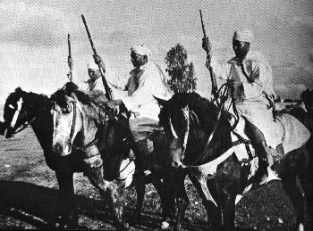
Islamic influence in Africa
Arabs migrated first to the northeastern regions, and then across the North going westward
Islam penetrated the continent through
Military conquests in the north
AND later
the presence of Muslim elites, traders, clerics and politicians traveled down into West Africa.

Slide 6
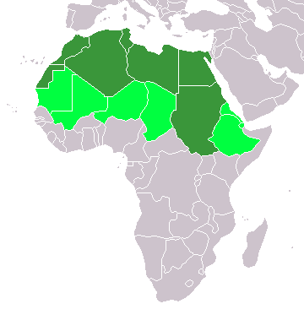
How Islam came to Africa
Military conquests
N. Africa and northern savana
(northern Africa; and eastern Africa)
Arabs became the ruling elite in North Africa
and they
Settled various regions
Notes:
www.solarnavigator.net/ geography/north_africa.htm

Slide 7
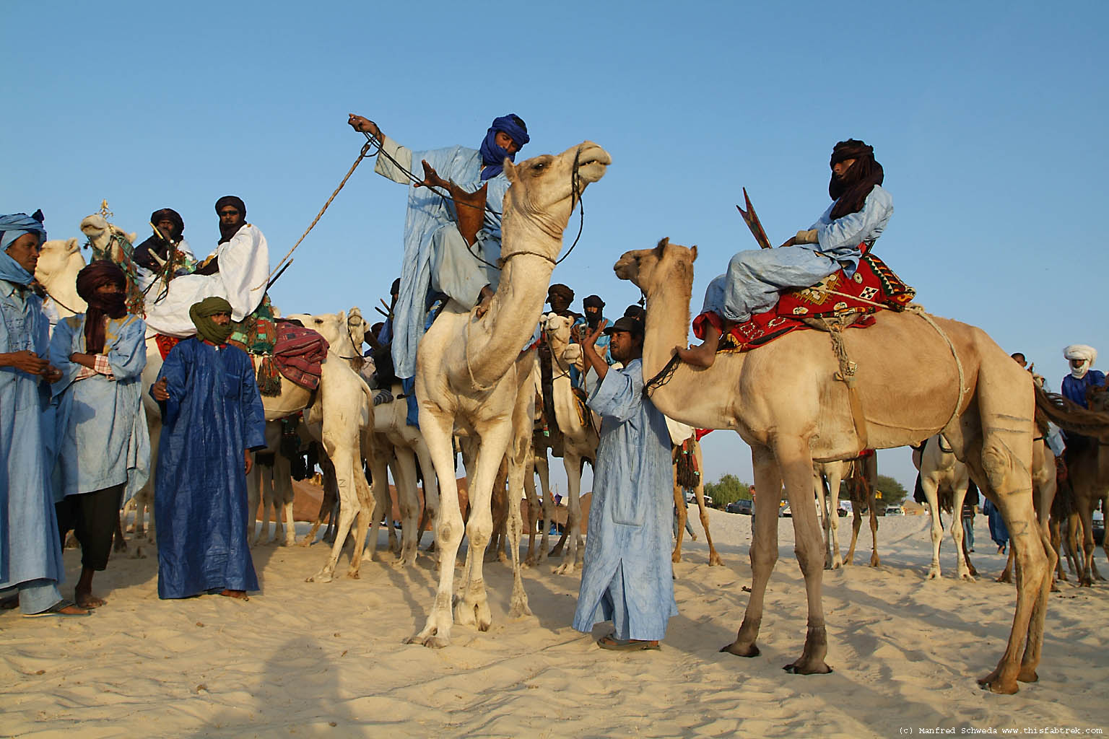
How Islam moved further south into sub-Saharan Africa
Commercial activity
Berber & Toureg Traders
South of the Sahara desert
Muslim traders (Berbers and others)
settled in commercial enclaves
Made allies with chiefs and kings
Notes:
archive.worldhistoria.com/ moors-were-black_to...
mathildasanthropologyblog.wordpress.com/.../

Slide 8
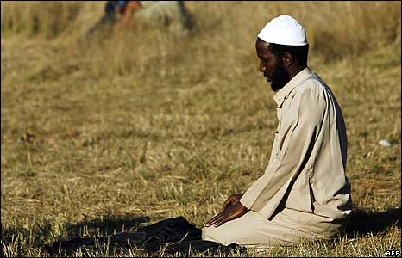
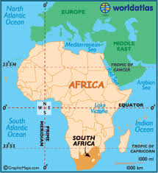
How Islam came to South Africa
Infiltration of Muslim castoffs and businessmen
Muslim slaves from Indonesia (prisoners) and
some Muslims were Indian traders who came through the region
Notes:
news.bbc.co.uk/2/ hi/in_pictures/7428297.stm

Slide 9
Beliefs
Most Muslims in Africa are of the Sunni branch of Islam, but there are also those of the Shia, Ibadi and Sufism sects.
Since the 2000s, Muslims comprise approx. 48% percent of Africa’s population

Slide 10
Central Beliefs of Islam
Only one God
Must follow God’s will to earn a place in paradise
Muhammad last in a line of prophets (Beg. w/ Abraham and other Jewish prophets)
Tolerant of Christians and Jews, but believe that people should obey the last and more complete revelation received and prescribed by Muhammad.

Slide 11
Key writings (texts) and codes of conduct
sunna: believer’s path of devotion, Muhammad & disciples
hadith: reports of Muhammad’s life
Qur’an: word of God, verses in Arabic
- considered a sacred language
ulama: learned ones, religious leaders
Sharia: “the way” moral code/Islamic Law
Setting parameters for acceptable
social behavior.

Slide 12
Part of the sunna (believer’s path)
5 pillars of faith
Publicly profess your surrender to God
Remember to give alms to the poor
Be sure to pray at set times during the day
Make a pilgrimage (journey) to holy place
Fast and be mindful during the month of Ramadan

Slide 13
History of Africans’ conversion to Islam
Many ideas in Indigenous/Traditional African practices were/and are similar to those in the Islamic faith
Belief in a Supreme God
They both have similar ethical values
They both make use of amulets and charms
Some say this made it easier to live together, easy for Africans to convert to, or adapt Islam into one’s religious outlook.

Slide 14
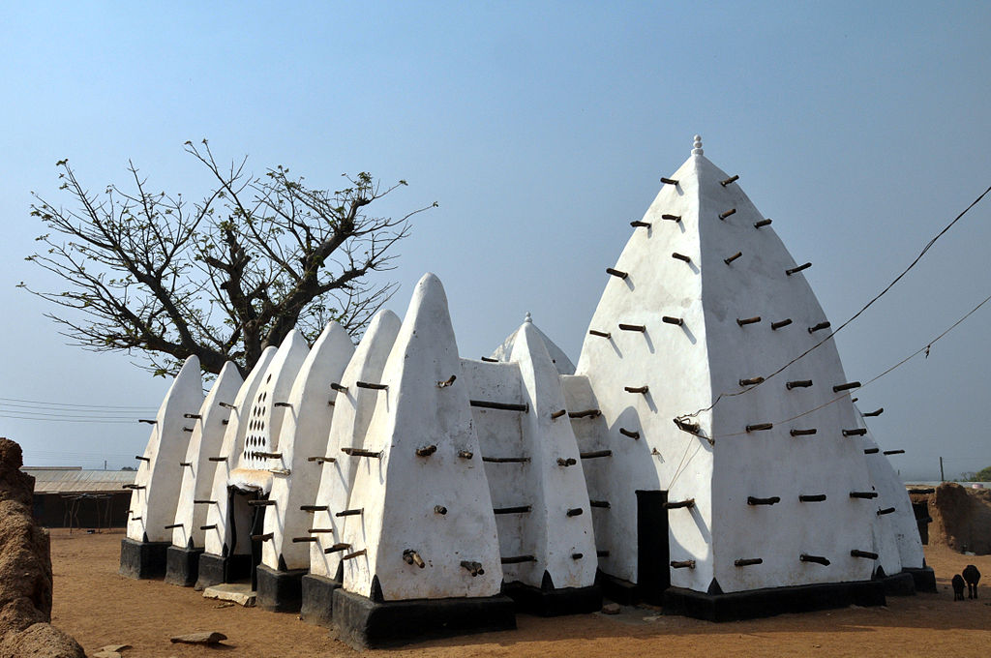
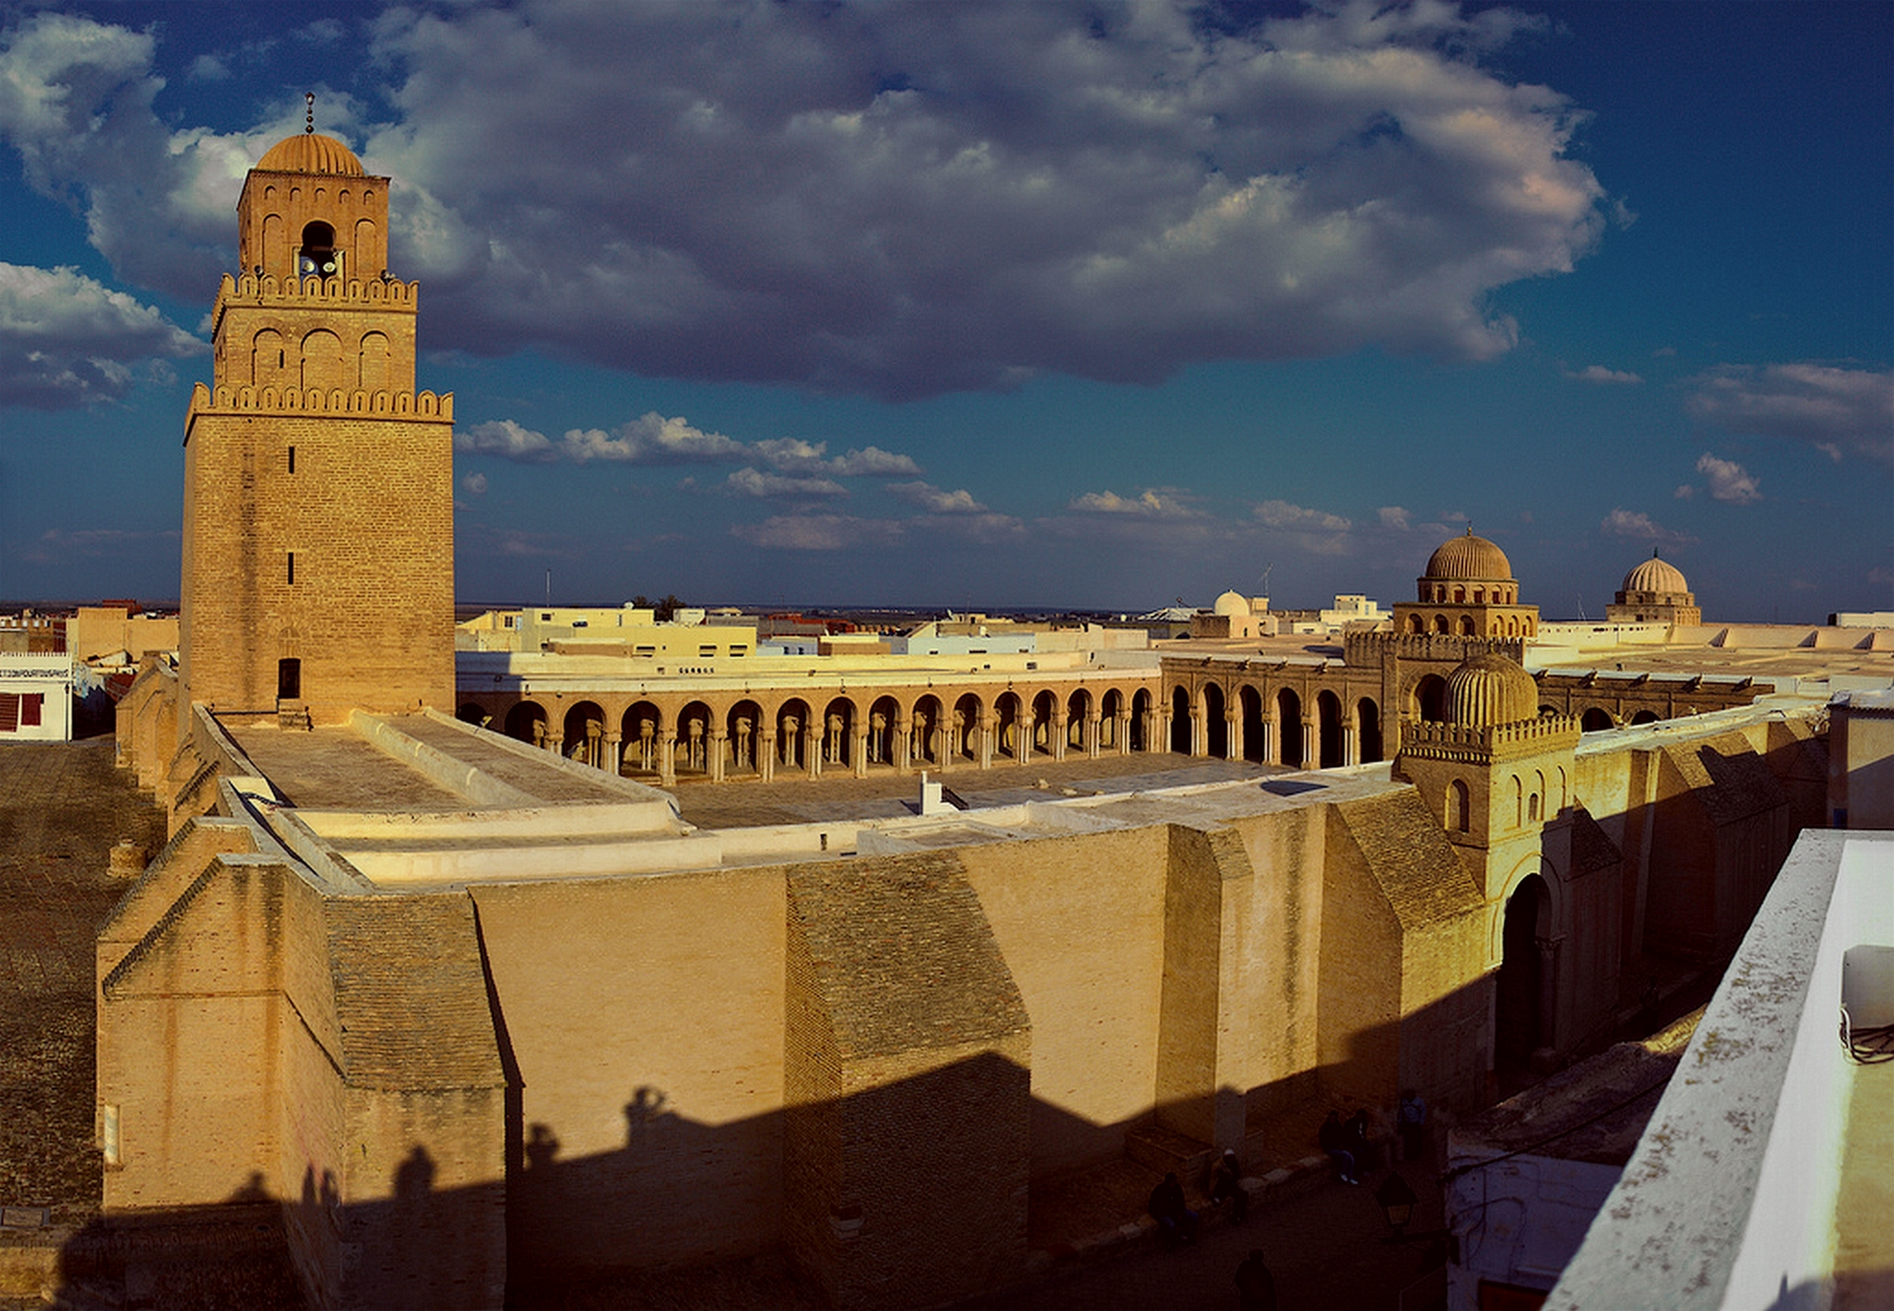
Holy Places – Islamic Architecture
The Mosque at Larabanga, Ghana
[one of the oldest surviving mosques – 1300s]
Great Mosque of Kairouan Panorama

Slide 15

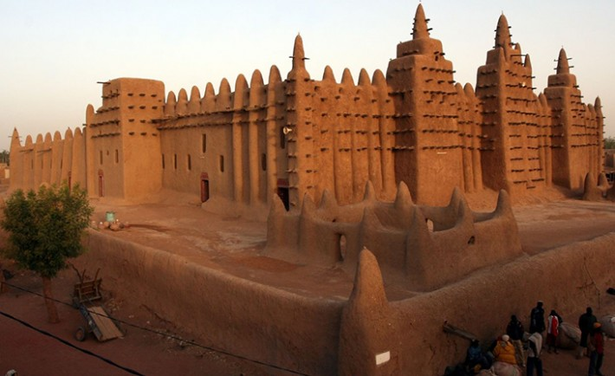
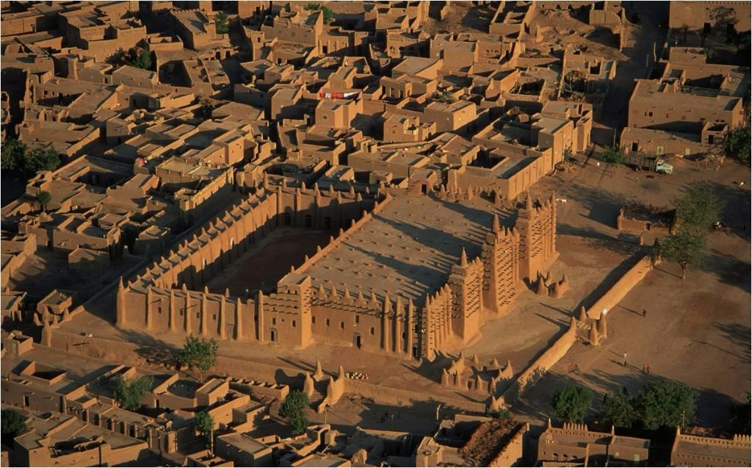
Important Mosque in Africa
Mosque at Djenne
Construction materials
Clay (mud)
In humid tropic earthenware structures require wood reinforcement,
So that heavy rains do not wash them away
Notes:
Masons of Djenné - City of Mud
5:12 mins
Published on Aug 23, 2013
Part one of a four part film series created for the exhibition, Mud Masons of Mali. Djenné masons speak of the history of city, its founding myth, its architecture and the role of the masons in maintaining this architectural legacy. The masons also speak about the importance for the community of the annual ceremony of re-plastering the Great Mosque.

Slide 16
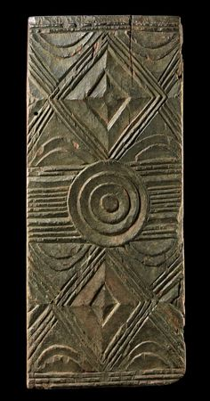
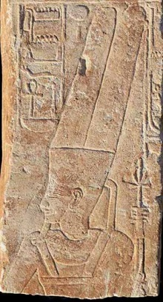
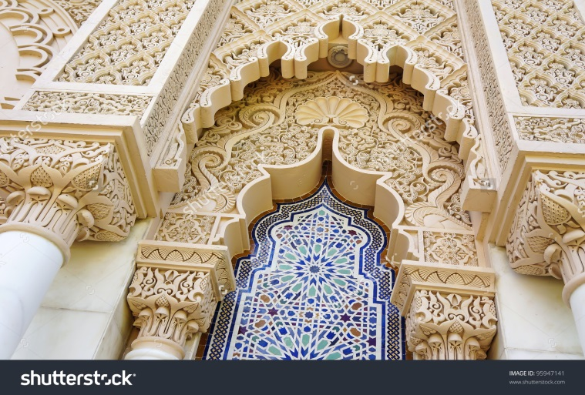
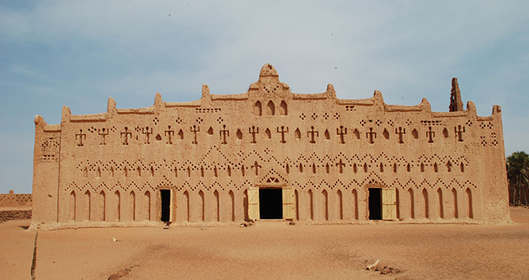
Designs and techniques
Masonry Patterns (ways of laying pre-made bricks)
carving large sections
Incising (cutting into stone)
Embossing (laying patterns into wet mud –
makes an impression
Filagree / mosaic tiles
The exterior walls of a palace can be covered with
elaborate decorative features from incisions and raised clay,
Many patterns are connected to Islamic writings
(messages from the Islamic faith)
Notes:
The exterior walls of a palace can be covered with elaborate decorative features from incisions and raised clay,
Many patterns are connected to Islamic writing

Slide 17
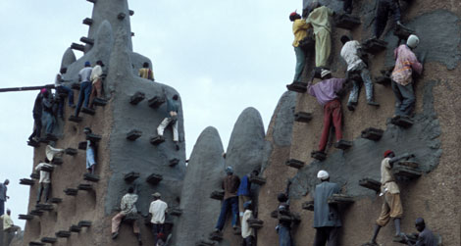
Islamic Architecture
Ongoing restorations of the Mosque
Masons- builders of mud brick structures
See
/ Masons of Djenné - City of Mud 5:12 mins
Published on Aug 23, 2013
https://www.youtube.com/watch?v=XiHOqxo5tpc

Slide 18
Christianity in Africa
Ancient Africa to present day

Slide 19
Christianity in African Society
Is also one of 3 Primary Religions throughout the continent: Traditional, Islam, & Christianity
Historically, Christianity had an impact on certain regions but also influences cultural traditions as well as politics.
Architecture/ art
music

Slide 20
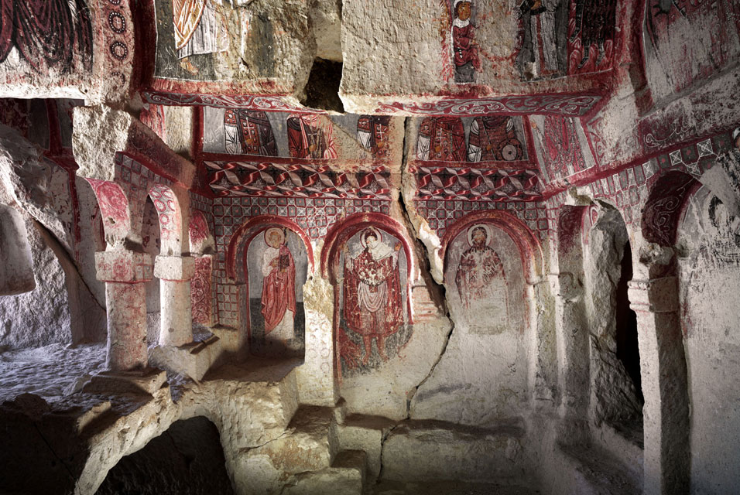
Late Antiquity – Africa north Africa 1-3 cent. / eastern Africa 3rd -5th centuries
Early African Christians played a central role in developing the modern university, providing Christian versions of holy texts (Scriptures),
An early form of Christian dogma (beliefs and thought).
Notes:
Author Thomas Oden How Africa Shaped the Christian Mind
IMAGE: http://mybyzantine.files.wordpress.com/2011/10/cap.jpg

Slide 21
The spread of Christianity
Pre-colonial and colonial periods
Later there was significant Christian missionary activity in Africa
during the Trans-Atlantic trading period Portuguese brought Catholic Christianity to West Africa late 1400s -1600s and onward
And during the colonial period late 1800s into the early 1900s
European protestant missionaries brought Christianity to places like Ghana and Nigeria,
In South Africa much sooner…
Dutch arriving early 1800s
Even though British explorations began in South Africa in 1775, Christianity took more force and influence during mid 1800s

Slide 22
Missionaries and their relationship with colonial officials
Many missionaries were agents within the European conquest of African states.
Early missionaries in South Africa: promoted superiority, must be a universality of beliefs, based on the exclusiveness of the Christian God.

Slide 23
African Independent Churches
African inspired, African led, African membership-dominated, African-centered
The Ethiopian Churches (emerged late 1800s)
in reaction to the Protestant mission churches.
A church where blacks could be leaders.
Beliefs and practices similar to Methodists, Presbyterian and Congregational Churches.

Slide 24
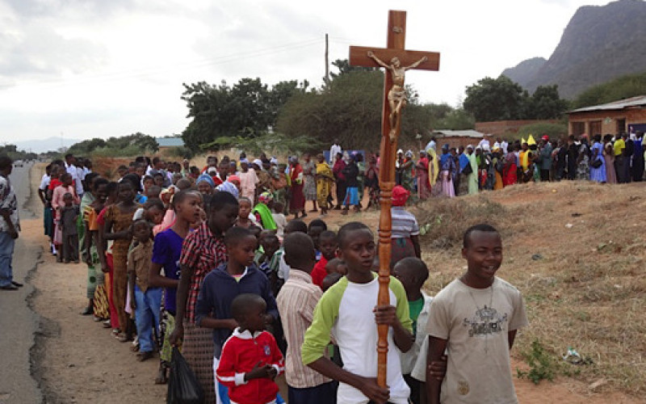
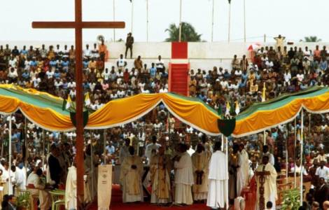
Christians Believe….
in a supreme God:
God the Father
that God took human form as Jesus Christ
that God is present today through the work of the Holy Spirit and evident in the actions of believers.
that Jesus’s death makes him a martyr / an important prophet of god
The resurrection of Jesus into heaven is important to Christians (recognized during the season of Easter) for this is how he overcame injustice and
became a spiritual presence (From the spirit world) for those still living

Slide 25
Beliefs
Christianity
Christians strongly believe in the holiness of the Christian worship and the communities of faith
Christians believe that there is a life after earthly death, and that there is salvation for believers who are repentant.
Some believe in Christ's second coming, the Day of Judgement

Slide 26
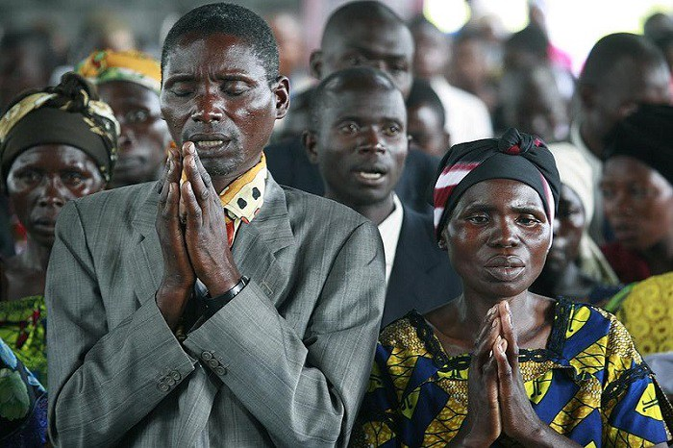
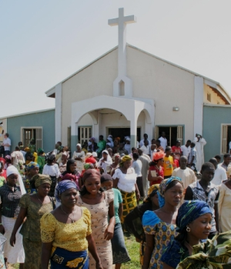
Practices
Prayer is the means by which Christians communicate with their God.
The church is the place where the Christian faith is nurtured and where the Holy Spirit is manifest on earth.
The holy writings are the Holy Scriptures (books of scriptures is known as the Bible)

Slide 27
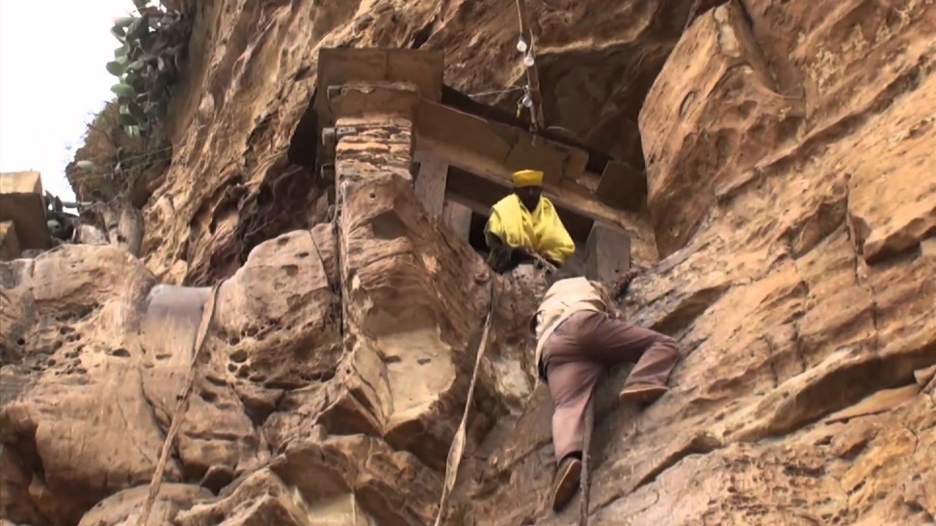
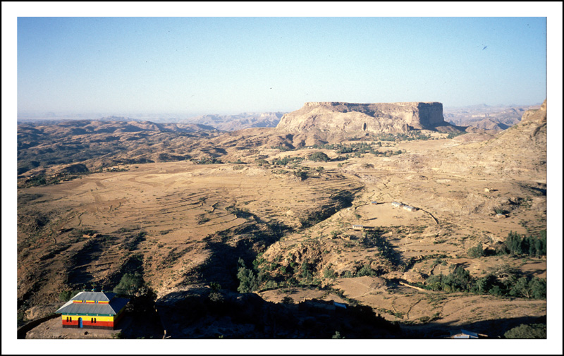
Other Religious structures
Christian cave monasteries in Ethiopia
Mountain monastery at Debre Damo

Slide 28
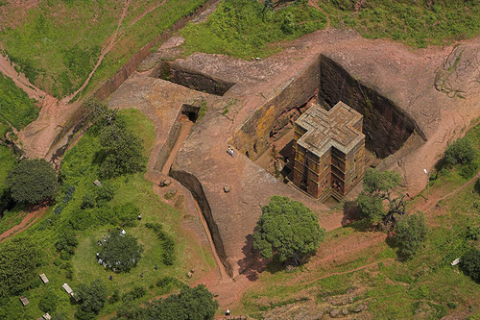
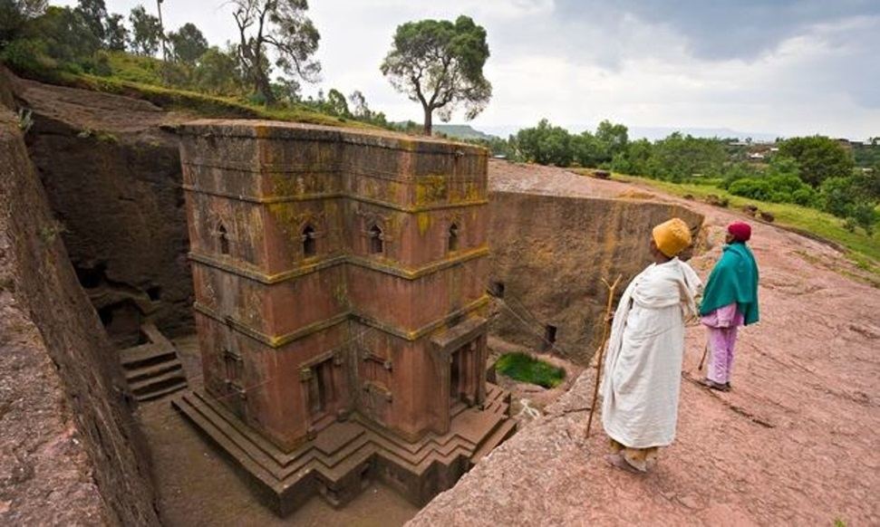
Religious structures
Early Christians - rock churches
Christian influence on African architecture has been minimal
With the Exception of churches in Ethiopia
11 churches were carved out of the red tufa rock
painted with biblical murals inside
https://www.youtube.com/watch?v=zI4N0KrDjLg
Notes:
http://www.britannica.com/art/African-architecture/Influences-of-Islam-and-Christianity

Slide 29
Music and Christianity
Contemporary Gospel Music in Tanzania (East Africa)
Active church choirs have also produced a vibrant gospel music scene. Singer Rose Muhando in 2011 signed a deal with Sony Music Entertainment, the first deal of its kind for East Africa. She is considered one of the most acclaimed gospel artists with a huge following throughout East Africa.
Tutamgusa || Rose Muhando Ft. Daudi || Official Video 2017 (5:00 mins)
https://www.youtube.com/watch?v=vGrcP6iEWcA

Slide 30
Resources
Ethiopia and its ancient Architecture video 56:54 mins
https://www.youtube.com/watch?v=WhdV6kiwZ1w
Masons of Djenné - City of Mud 5:12 mins
Smithsonian’s National Museum of Natural History Published on Aug 23, 2013. https://www.youtube.com/watch?v=XiHOqxo5tpc
Lalibela - the history behind the Rock churches of Ethiopia
9:00 mins
https://www.youtube.com/watch?v=zI4N0KrDjLg

